Slide 1
Illicit Drugs
As if Alcohol and Tobacco
Weren’t Enough…

Slide 2
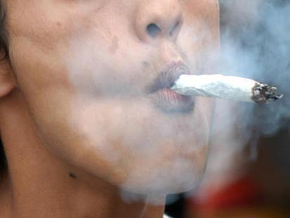
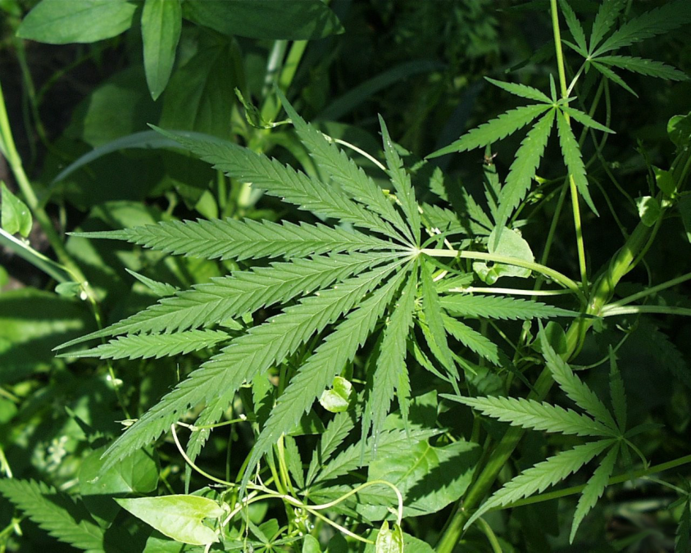
Marijuana
“High for a night, slow for a month”

Slide 3
Ecstasy

Slide 4
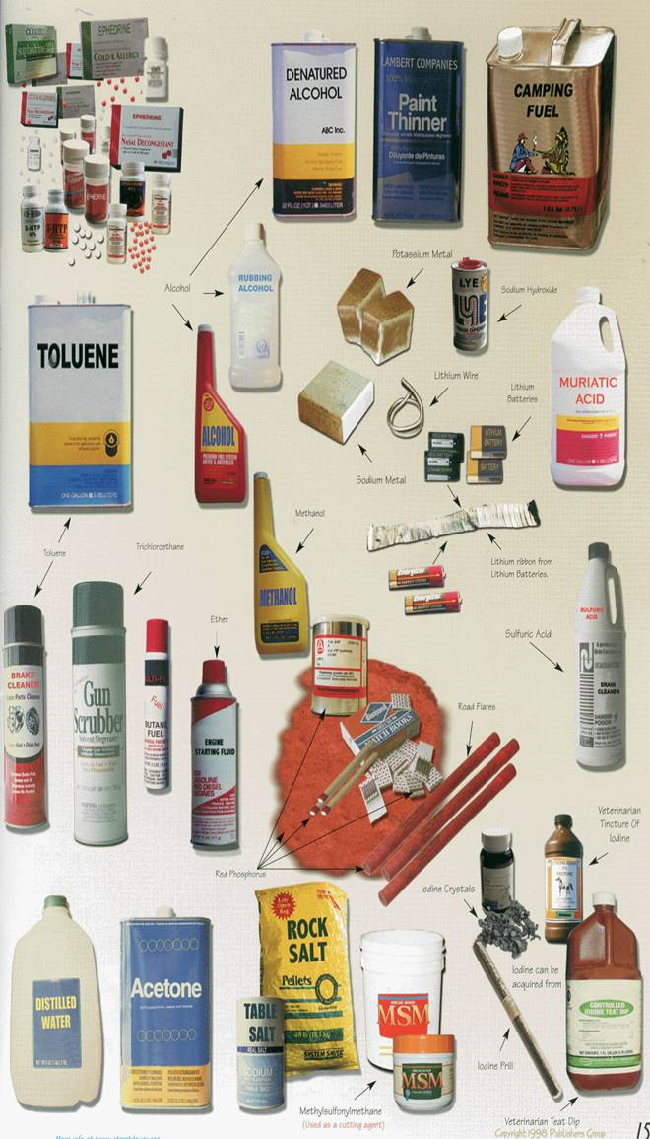
Methamphetamines

Slide 5
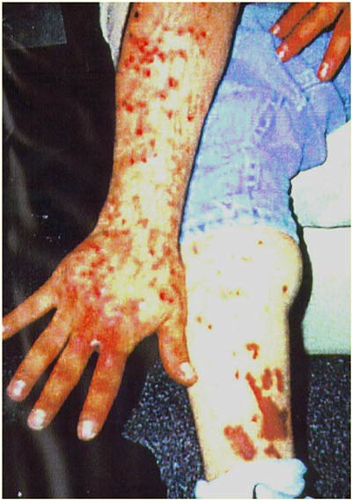
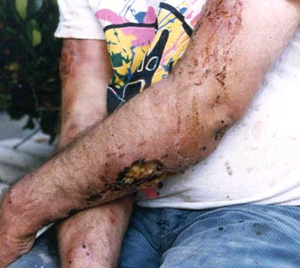
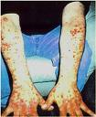
“Meth Mites”

Slide 6
Methamphetamines
1 year later…

Slide 7
Methamphetamines
8 months later…

Slide 8
Methamphetamines
4 years later…

Slide 9
Methamphetamines
3 months later…

Slide 10
Methamphetamines

Slide 11
Methamphetamines
18 months later…

Slide 12
Methamphetamines
The worst one…

Slide 13
Methamphetamines

Slide 14
Methamphetamines

Slide 15
Methamphetamines

Slide 16
Methamphetamines

Slide 17
Methamphetamines

Slide 18
Methamphetamines

Slide 19
Methamphetamines

Slide 20
Methamphetamines

Slide 21
Methamphetamines

Slide 22
Methamphetamines

Slide 23
Methamphetamines

Slide 24
Methamphetamines

Slide 25
Methamphetamines

Slide 26
Methamphetamines

Slide 27
Methamphetamines

Slide 28
Methamphetamines

Slide 29
Methamphetamines

Slide 30
Methamphetamines

Slide 31
Methamphetamines

Slide 32
Methamphetamines

Slide 33
Methamphetamines

Slide 34
Methamphetamines

Slide 35
“Meth Mouth”
Acid destroys enamel
Dry mouth lets bacteria grow
Clenching/grinding teeth
Craving sugary drinks
Neglected hygiene

Slide 36
“Meth Mouth”

Slide 37
“Meth Mouth”

Slide 38
“Meth Mouth”

Slide 39
“Meth Mouth”

Slide 40
“Meth Mouth”

Slide 41
“Meth Mouth”

Slide 42
“Meth Mouth”

Slide 43
“Meth Mold”
Mostly Women
White
Poor
Rural areas
30’s & 40’s
Skeletal
“Meth Mouth”
“Meth Mites”
Violent
Truck drivers

Slide 44
“Congratulations! You lost weight!”

