Slide 1
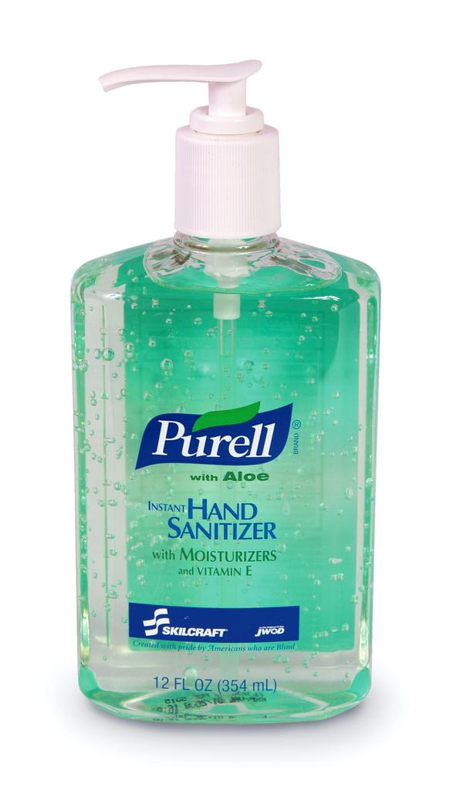
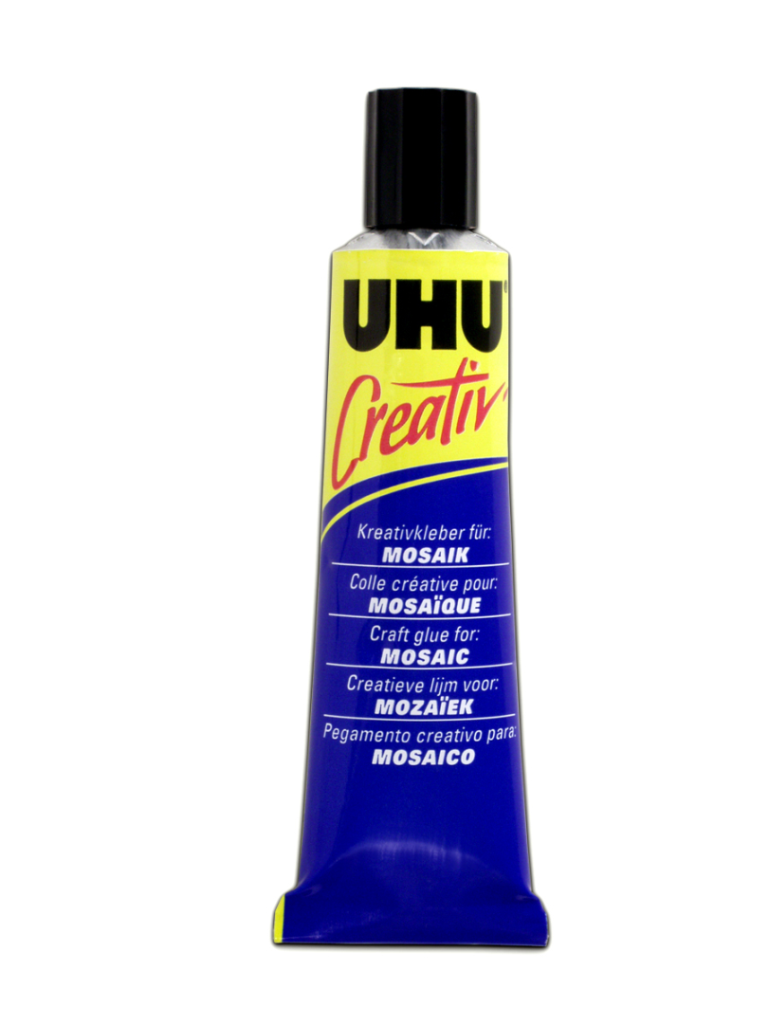
Inhalants

Slide 2
Dangers of Inhalants
Headache
Nosebleeds
Dizziness
Vomiting
Kidney & liver failure
Brain damage
Memory problems
Mental retardation
Death

Slide 4
Flat-Line
(Pass-Out Game, Space Monkey, Choking Game)
VIDEO

Slide 5
Story Time
Space Monkey at Camp

Slide 6
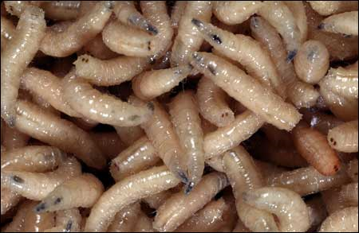
‘Smoking’ Smarties
DANGERS—
Sinus infections
Severe lung infections
Making smoking look ‘cool’ to younger kids
The rare risk of growing maggots in your sinuses

