Slide 1
Social Health
Conflict

Slide 2
What is a conflict
A disagreement between two or more people or between toe or more choices.

Slide 3
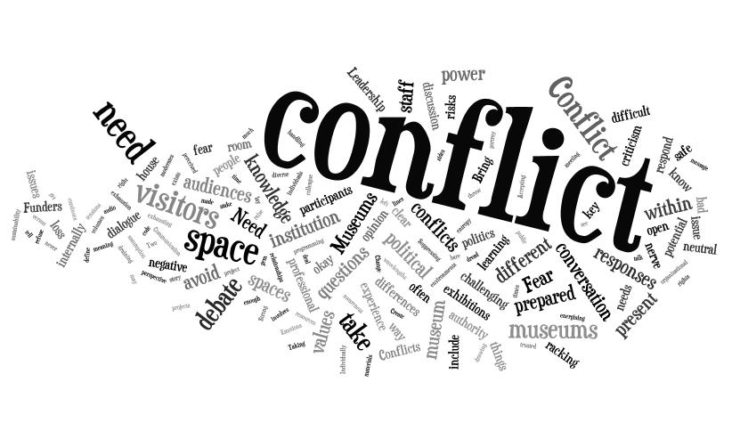
Types of Conflict
Intrapersonal
Interpersonal
Intragroup
Intergroup

Slide 4
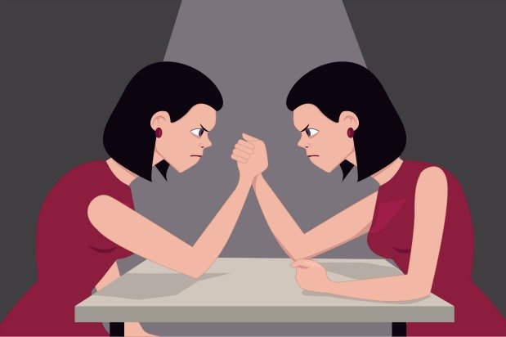
Intrapersonal Conflict
Any conflict that occurs within a person

Slide 5
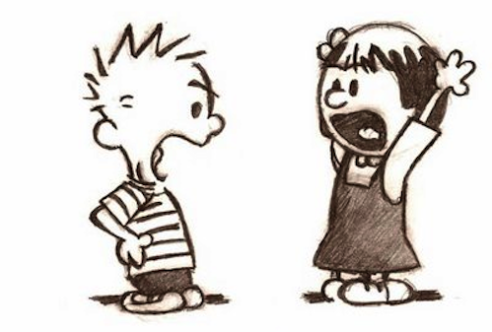
Interpersonal Conflict
Any conflict that occurs between two or more people.

Slide 6
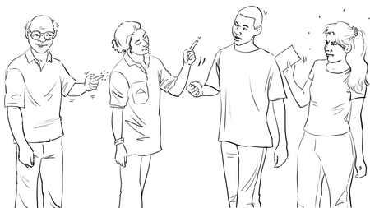
Intragroup Conflict
A difference between people belonging to the same group.

Slide 7
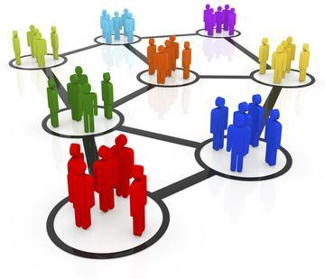
Intergroup Conflict
A disagreement between two or more groups of people.

