Slide 1
Alcohol
(Ethanol)
CH₃CH₂OH

Slide 2
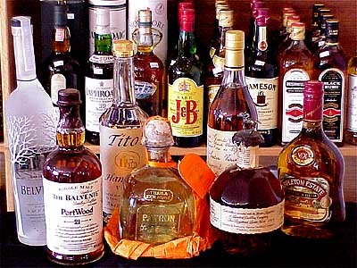

Slide 3
Physical Effects
Impaired judgment
Slurred speech
Loss of muscle coordination
Stupor
Nausea and vomiting
Headache
Loss of consciousness
Memory loss
Hangover

Slide 4
Depression in a bottle

Slide 5
Consequences of Alcohol
Addiction
Injuries
Arrests
Abuse
HS Drop-outs
Divorce
Murder
Getting fired
Cancer
Cirrhosis
Birth defects
Prison sentences
Drunk Driving

Slide 7
Blood Alcohol Content (BAC)
0.00% No alcohol in your blood
0.08% Legal intoxication (about 3 drinks)
0.20% Loss of consciousness
0.40% Death

Slide 8
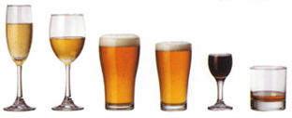
Alcohol Content
5 proof = 2.5% alcohol (beer)
20 proof = 10% alcohol (Nyquil)
30 proof = 15% alcohol (wine)
80 proof = 40% alcohol (hard liquor)
200 proof = 100% alcohol (pure alcohol)

Slide 9
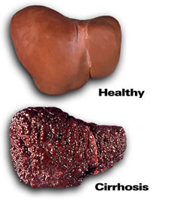
Alcohol Metabolism
Liver can metabolize about 1 drink every hour

Slide 10
Types of Drinking
Ritual drinking—religious, traditional, etc
Social drinking—only with others
Alcoholism—3 or more drinks daily
Solo drinking—drinking alone
Binge drinking—4/5 drinks
Most deadly type
Typical teen drinking style

Slide 12
What do you think of when you imagine a party with alcohol?

Slide 14
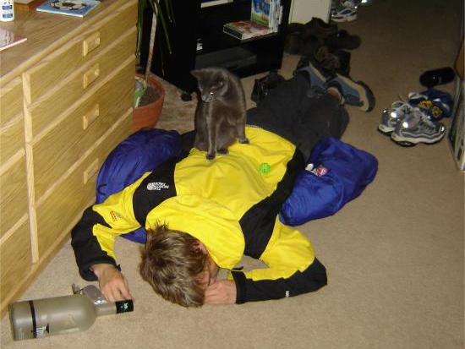

Slide 16
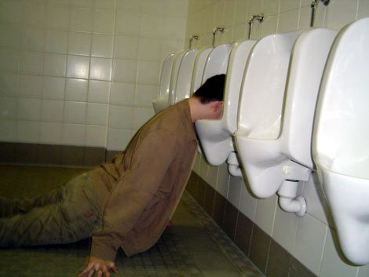

Slide 17
Alcohol kills 100,000 people each year!!!!

Slide 19
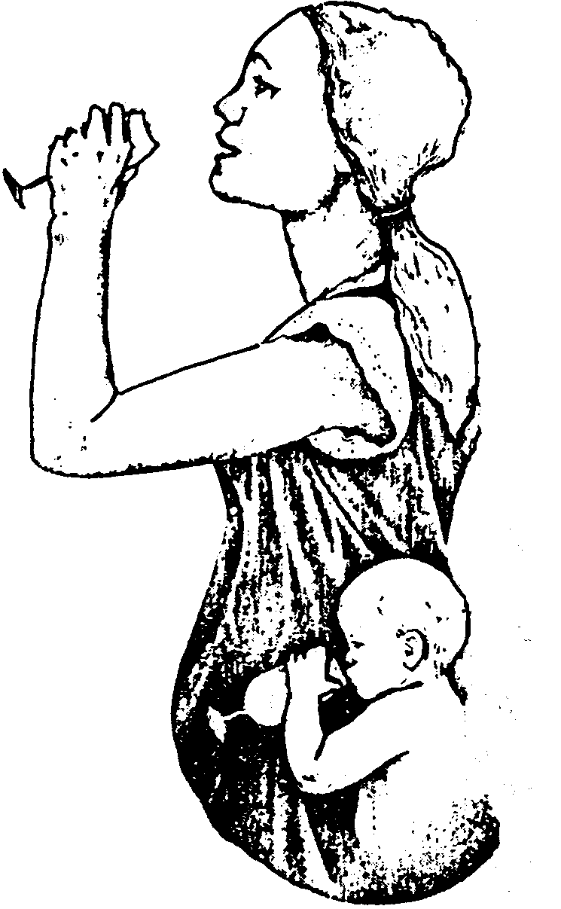
Fetal Alcohol Syndrome

Slide 20
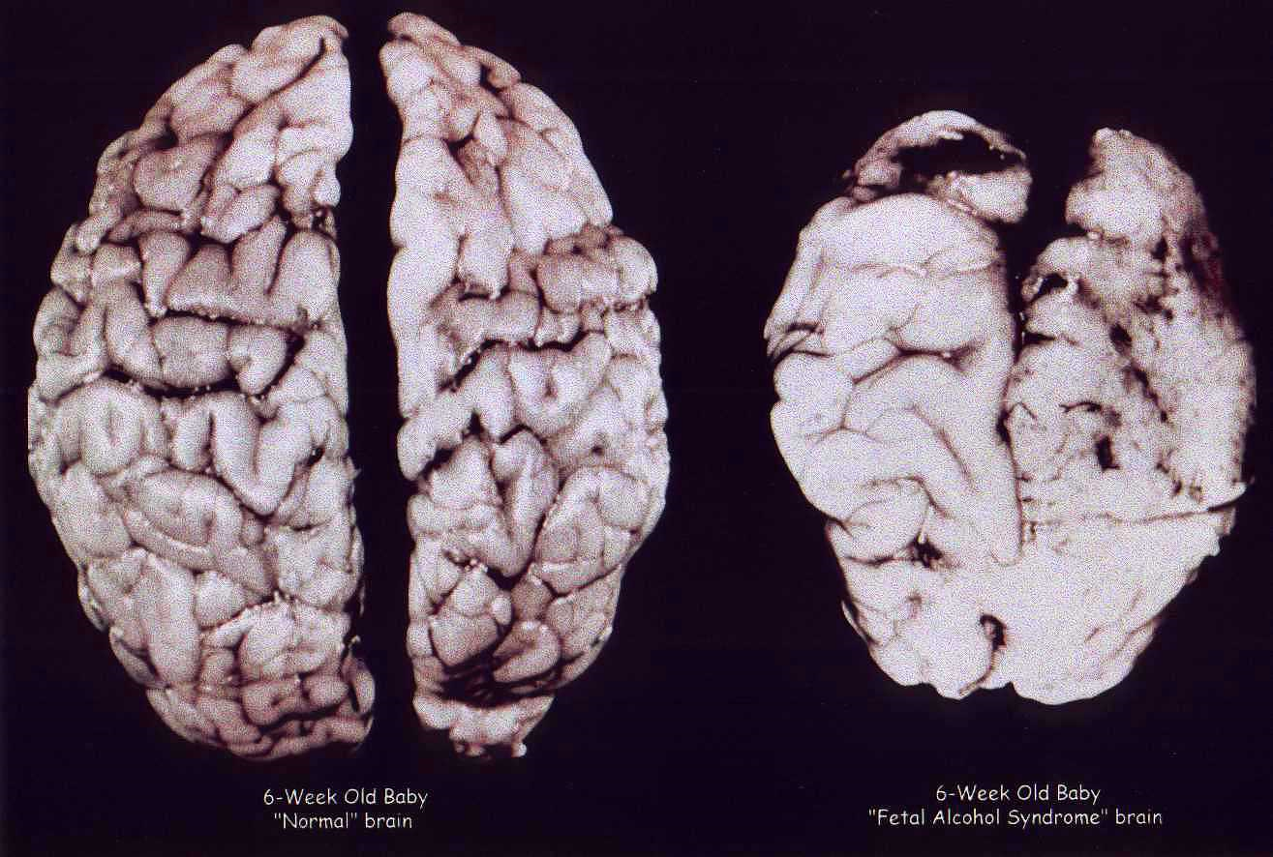

Slide 21
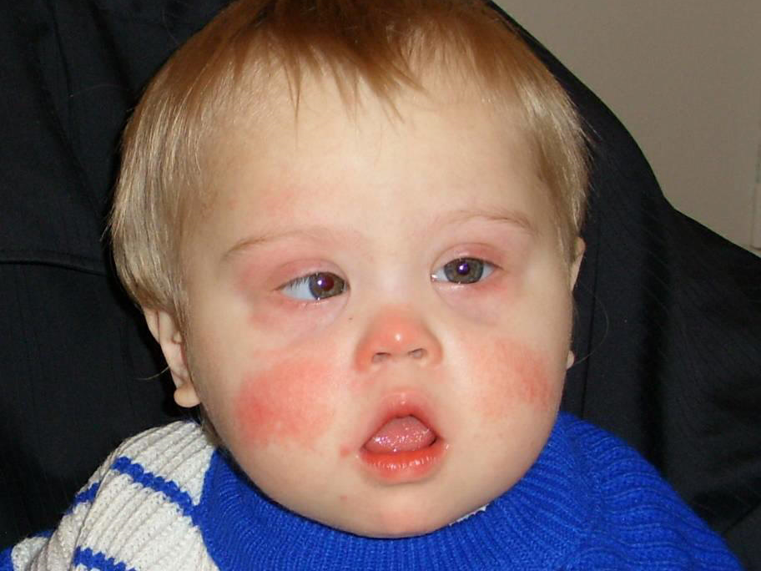

Slide 22
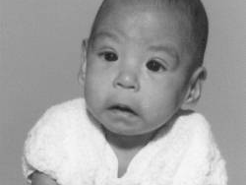

Slide 23
Alcoholism is one of the most difficult addictions to break

Slide 24
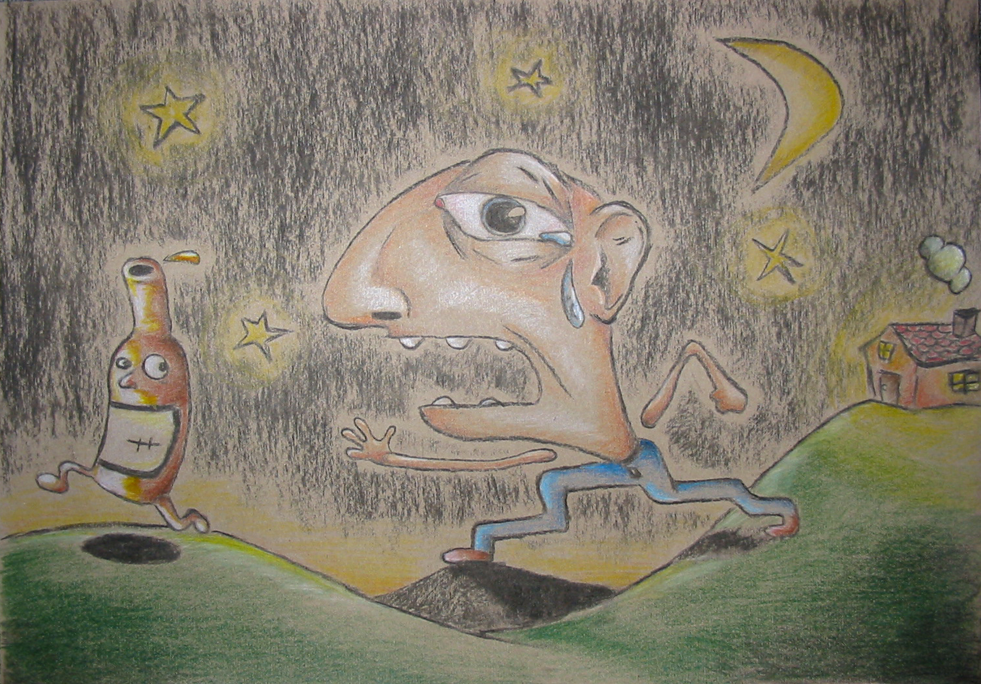

Slide 25
You can’t ever have enough of what you don’t need, because what you don’t need will NEVER satisfy you.

Slide 26
Alcohol Increases the Risk of…
Being divorced
Being poor
Dropping out of school
Getting raped
Depression
Suicide
Dying violently

Slide 28
The Most Dangerous Thing about Alcohol…
Your judgment is the first to be impaired, so you don’t realize how drunk you are

Slide 29
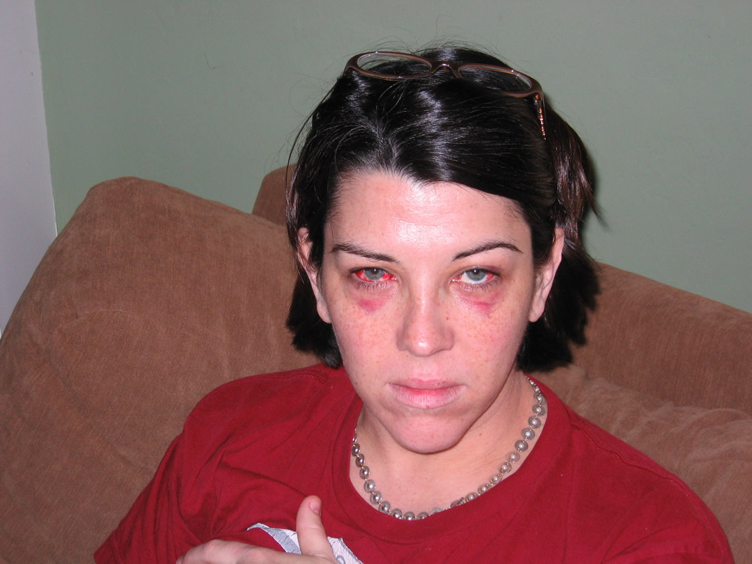

Slide 30
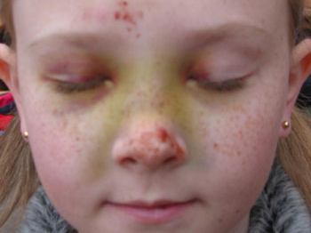

Slide 32
