Slide 1
Emotional Health

Slide 2
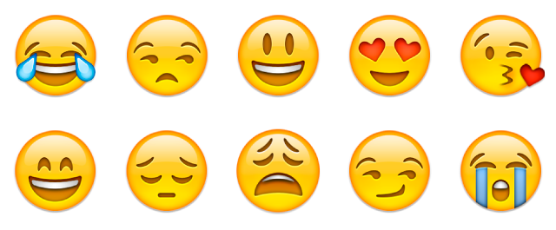
Basic Human Emotions
Happy
Sad
Love
Hate
Anger
Fear

Slide 3
Expressing Emotions
People express emotions in a variety of ways.
How do children express emotions?
How do teens express emotions?
How do adults express emotions?
We learn how to control and express our emotions appropriately as we grow older.
Do you express your emotions differently around different people? (Family, friends, work, school, etc.)

Slide 4
Consequence of Uncontrolled Emotions
Mental
Factors that affect an individual emotionally because of the behavior.
Social
Effects on the community, family and individuals because of the behavior.
Spiritual
Moral and religious values that are violated because of the behavior.
Physical
Harm or injury that can come to people because of the behavior.

Slide 5
Consequence of Uncontrolled Emotions
Financial
Dollar costs to individuals and communities as a result of behavior.
Legal
Results in choosing behaviors that are against the law.

Slide 6
Guide to expressing your emotions…
Recognize your feelings
Answer this question, “How do you feel?”
Monitor your nonverbal behavior.
Monitor your thoughts as well as your actions.
Think about how to describe your feelings
Use single words: “excited” or “depressed”
What’s happening to you: “I’m on top of the world”
What you’d like to do: “I feel like giving up”

Slide 7
Guide to expressing your emotions…
Recognize the difference between thinking, feeling, and talking
Feeling something, talking about it, and then acting on that
Feeling can sometimes be destructive or liberating
Understand the consequences of your actions
Accept responsibility for your feelings
Instead of, “You make me so angry” say, “I am feeling angry”
Consider when to share your feelings
Wait until you have thought out carefully how you might express your feelings in a way that would be most likely to be heard.

Slide 8
Emotional Intelligence
The capacity to be aware of, control, and express one's emotions, and to handle interpersonal relationships judiciously and empathetically.

Slide 9
Emotional Intelligence
What is EI? – more details
https://www.youtube.com/watch?v=weuLejJdUu0
In your notes: How has EI and describe how and why you know this.
https://www.youtube.com/watch?v=kdhjztWMnVw
Extra EI: https://www.youtube.com/watch?v=pp71BH0UlvE

Slide 10
How Emotions Work…
How the brain works
Identification of emotions
Emotional triggers
Positive self-regard
Application of personal awareness (Emotional Intelligence)

Slide 11
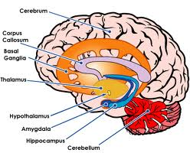
The Brain -Limbic System: Emotional Control
Hippocampus: emotions & memory Amygdala: emotional control & fear control Hypothalamus: regulates fear & aggression

Slide 12
Strategies to help us deal with our emotions
Take 5 minutes – walk away
Breathing: 3 deep breaths
Reflection – what happened?
Talk to a mentor
Journal
Exercise
Listen to music
Seek help form a professional

Slide 13
Inside Out
In your notes identify the different emotions:
https://www.youtube.com/watch?v=AQ3hjymiCCg
https://www.youtube.com/watch?v=_FB1bG86fzE

Slide 14
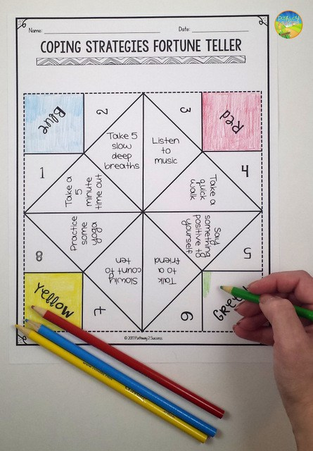
Emotional Coping Strategies Fortune Teller
https://s-media-cache-ak0.pinimg.com/736x/c3/5b/f7/c35bf733d2b8cbc33959f33e0b66ed3c.jpg?vm=r

