Slide 1
Myth Busters
Can you separate medical fact from fiction?

Slide 2
Scoring
Unanimous (3/3 correct) 5 points
Majority (2/3 correct) 3 points
Minority (1/3 correct) 1 point
Incorrect (0/3 correct) nada/zilch/squat
Last 5 questions
are worth extra points

Slide 3
To build muscle, most Americans need to eat a lot more protein

Slide 4
FALSE

Slide 5
Sit-ups help you to lose stomach fat

Slide 6
FALSE

Slide 7
“What you eat is what you are”

Slide 8
TRUE

Slide 9
Exercising in the morning speeds up your metabolism for the rest of the day

Slide 10
FALSE

Slide 11
The skin of potatoes contains nearly all of the vitamins and minerals

Slide 12
TRUE

Slide 13
The crust of bread is especially high in vitamins and minerals

Slide 14
FALSE

Slide 15
Exercising builds up an appetite

Slide 16
FALSE

Slide 17
Americans get most of their vitamin C from potatoes

Slide 18
TRUE

Slide 19
Fat-free food has no calories

Slide 20
FALSE

Slide 21
Chewing gum takes 7 years to pass through your digestive system.

Slide 22
FALSE

Slide 23
Diet soda has no calories

Slide 24
TRUE

Slide 25
Muscle weighs twice as much as fat

Slide 26
FALSE

Slide 27
Eating less salt can lower your blood pressure.

Slide 28
TRUE

Slide 29
Women have more fat than men

Slide 30
TRUE

Slide 31
Exercise turns fat into muscle

Slide 32
FALSE

Slide 33
It takes more calories to eat celery than you get from it

Slide 34
FALSE

Slide 35
If women lift weights they will get too muscular

Slide 36
FALSE

Slide 37
Men burn more calories than women

Slide 38
TRUE

Slide 39
Shaq is technically obese

Slide 40
TRUE

Slide 41
Eating chocolate causes acne.

Slide 42
FALSE

Slide 43
Michael Phelps has 1% body fat

Slide 44
FALSE

Slide 45
Because of obesity, American kids will live shorter lives than their parents

Slide 46
TRUE

Slide 47
Eating turkey makes you tired

Slide 48
TRUE

Slide 49
Adults need to drink 8 glasses of water each day

Slide 50
FALSE

Slide 51
Vitamin C prevents colds

Slide 52
FALSE

Slide 53
After age 30, people start shrinking

Slide 54
TRUE

Slide 55
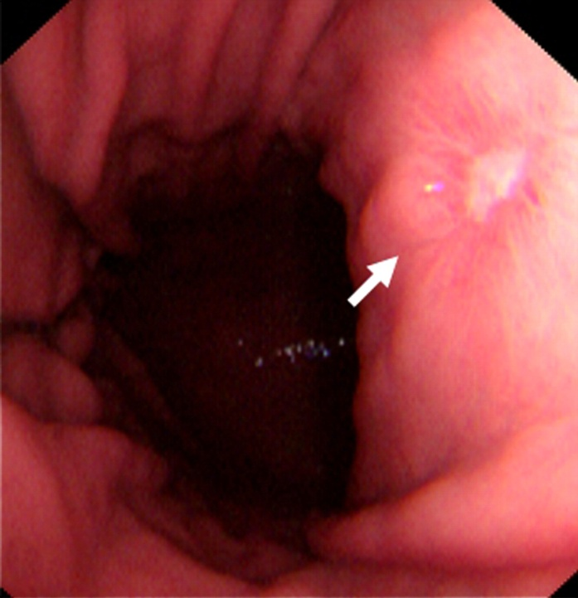
Stomach ulcers are caused by stress

Slide 56
FALSE

Slide 57
Organic food has more vitamins & minerals

Slide 58
FALSE

Slide 59
You should wait an hour after eating before swimming

Slide 60
FALSE

Slide 61
Obesity is the #1 preventable cause of death in the US

Slide 62
TRUE

Slide 63
It’s very important to stretch before you work out

Slide 64
FALSE

Slide 65
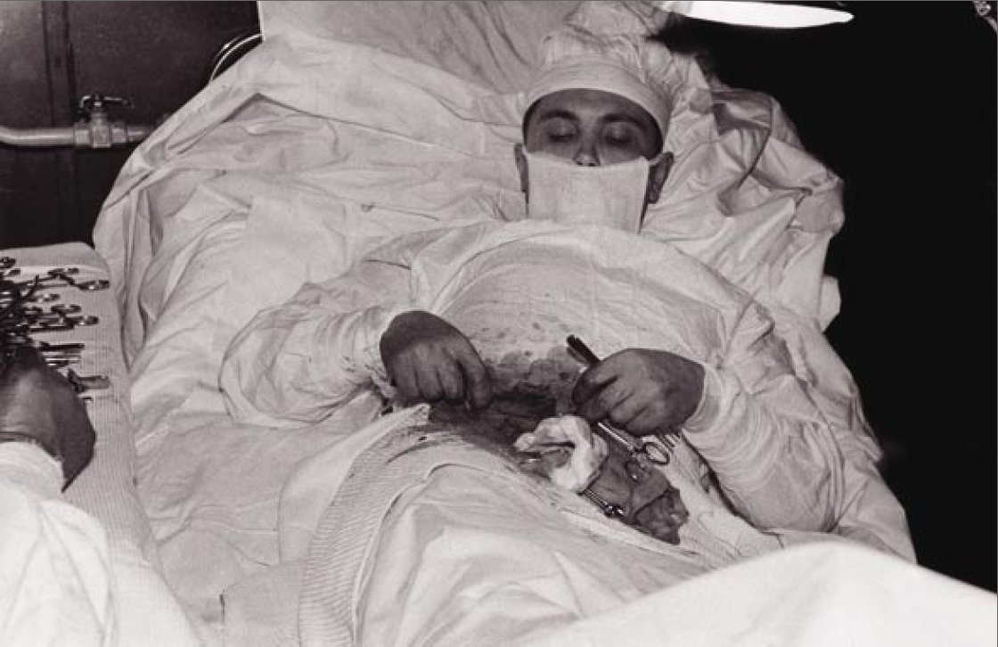
The appendix has no purpose

Slide 66
FALSE

Slide 67
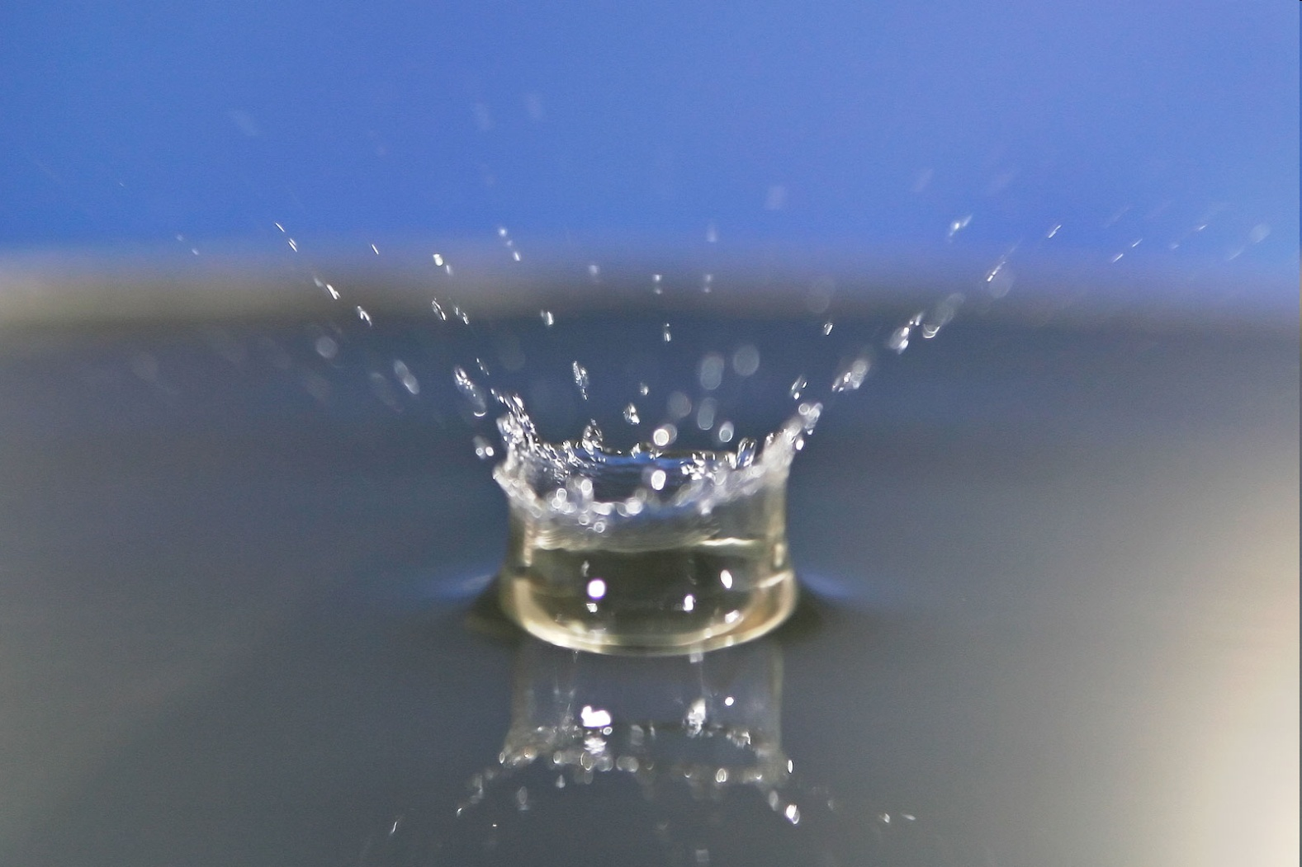
We are about 70% water

Slide 68
TRUE

Slide 69
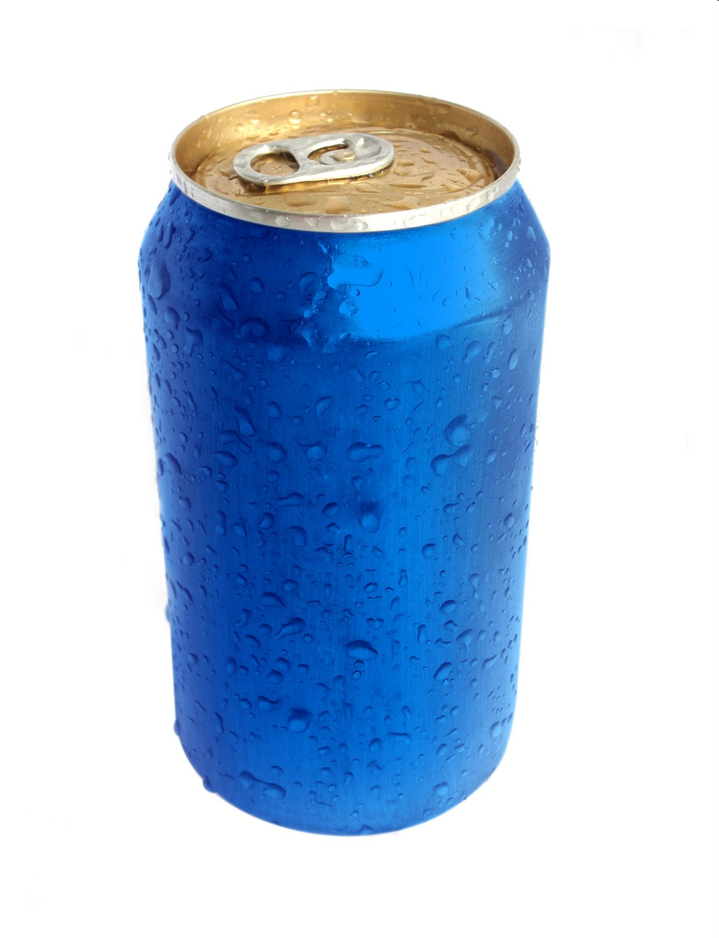
You sweat about a 6-pack of water daily

Slide 70
TRUE

Slide 71
If you stop exercising, your muscle turns into fat

Slide 72
FALSE

Slide 73
You burn more calories sleeping than watching TV

Slide 74
TRUE

Slide 75
Eating spicy food causes your nose to run.

Slide 76
TRUE

Slide 77
Kids in big cities are more likely to be obese

Slide 78
FALSE

Slide 79
Muscle burns more calories than fat cells

Slide 80
TRUE

