Slide 1
First-aid

Slide 2
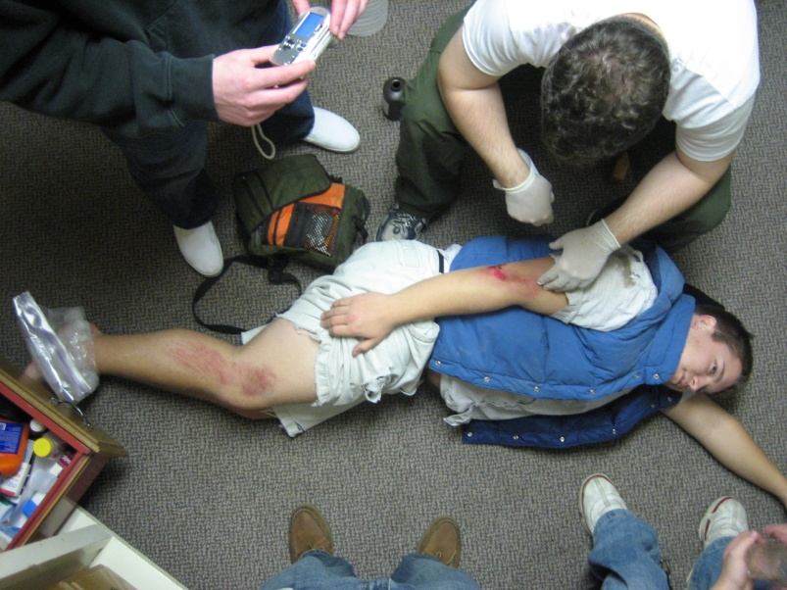
6 Lifesaving Skills
Stay calm/assertive in an emergency
Treat for shock
Prevent disease transmission
Stop severe bleeding
Prevent further injury
CPR

Slide 3
1. Stay Calm
You can’t help unless you are calm
Your calmness and confidence is comforting
What works for me:
Close your eyes
Take several deep breaths
Pretend to have sangfroid

Slide 5
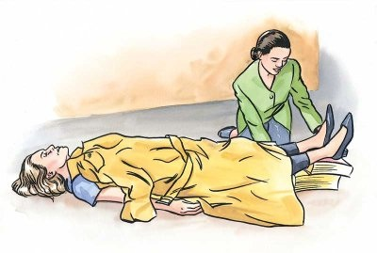
2. Treat for Shock
Shock = Psychological reaction to trauma
Always treat for shock!
Talk to them, keep them calm
Keep the person warm
Raise their legs

Slide 6
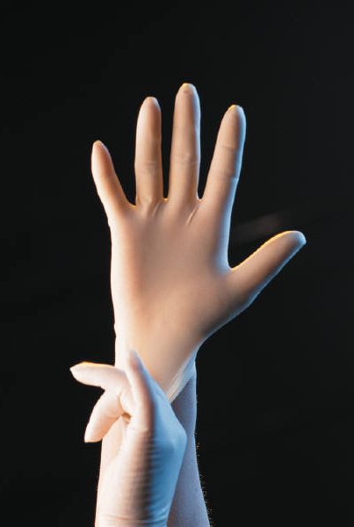
3. Prevent Disease Transmission
Don’t touch other people’s blood
Wear gloves while giving first-aid
Throw-away bloody materials
Use clean first-aid supplies

Slide 7
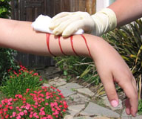
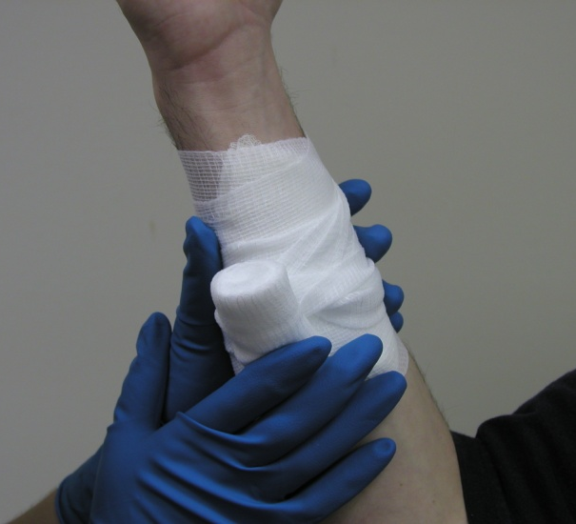
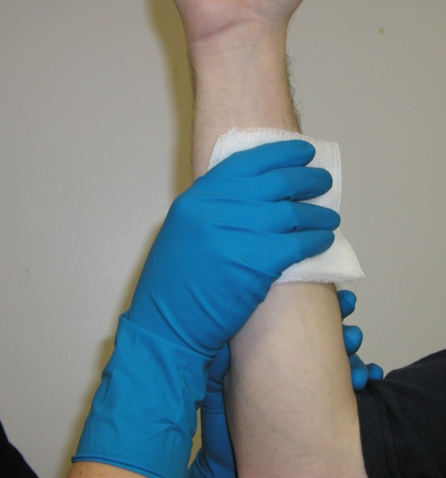
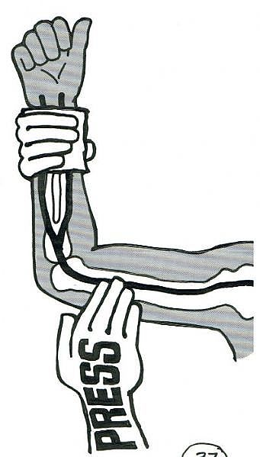
4. Stop Severe Bleeding
Put on gloves
Use a gauze pad, or improvise
Hold on securely, or wrap
Elevate the wound
(pressure points)

Slide 8
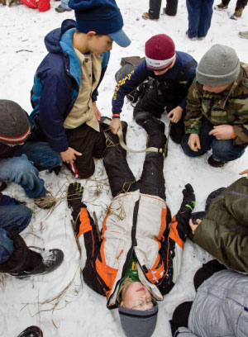
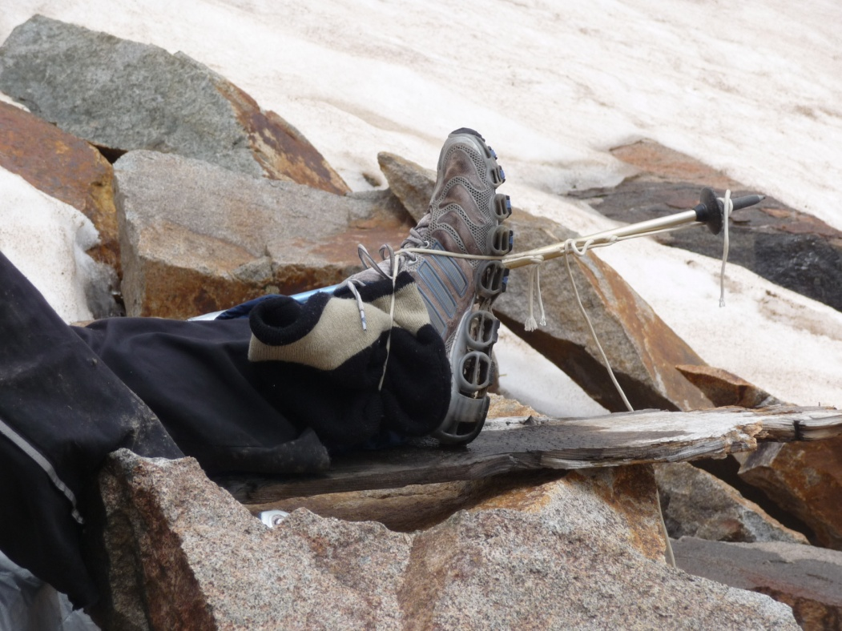
5. Prevent Further Injury
DON’T move the person
Protect the head and neck
Immobilize injuries

Slide 9
6. CPR
To be continued…

