Slide 1
DIFFERENT EMOTIONS

Slide 2
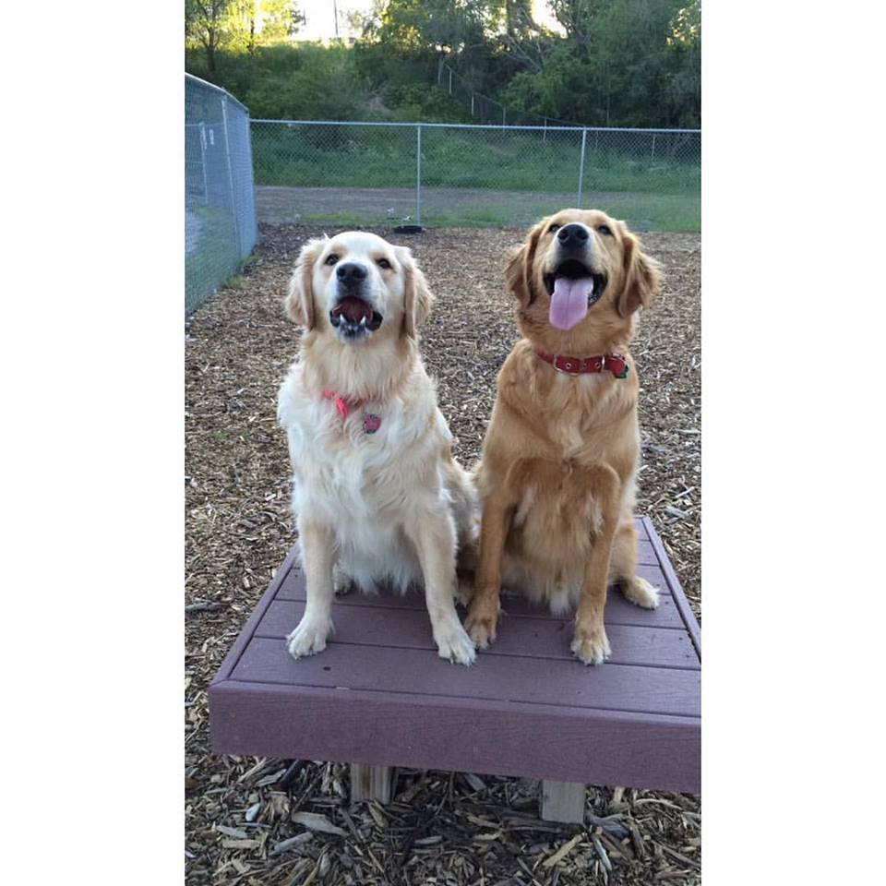
In LOVE

Slide 3
SORROW

Slide 4
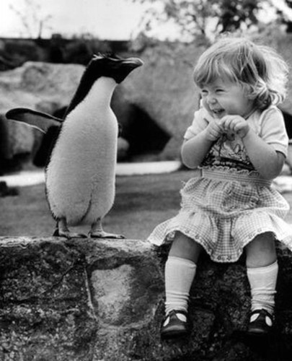
INNOCENCE

Slide 5
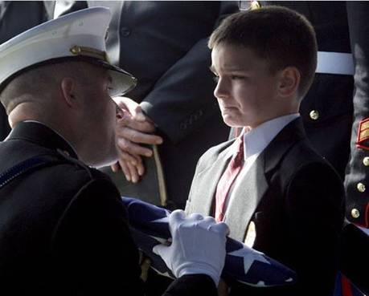
DEPARTURE

Slide 6
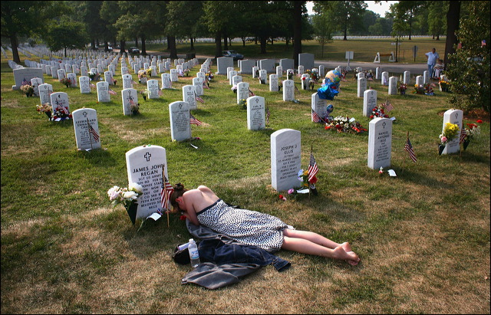
PAIN

Slide 7
SOLITUDE

Slide 8
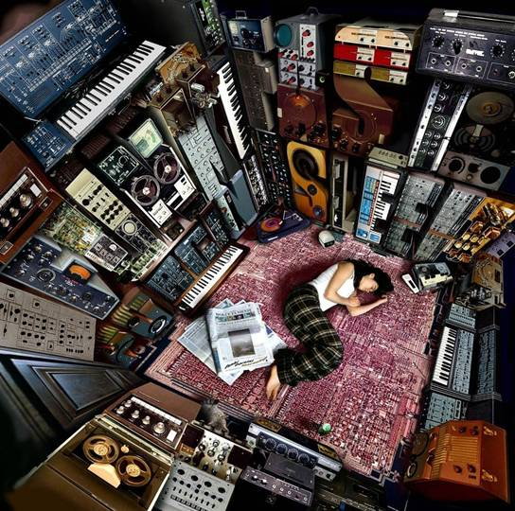
MUSIC

Slide 9
RESPECT

Slide 10
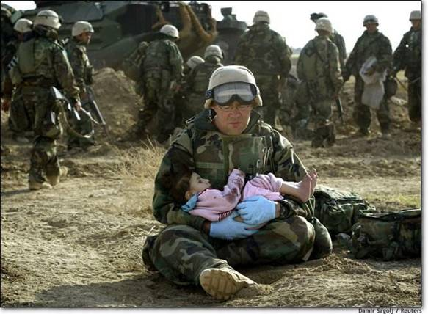
COMPASSION

Slide 11
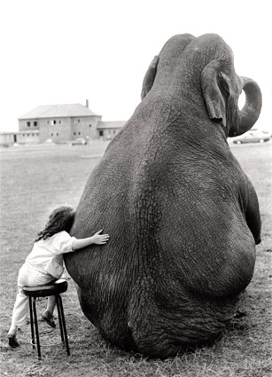
FRIENDSHIP

Slide 12
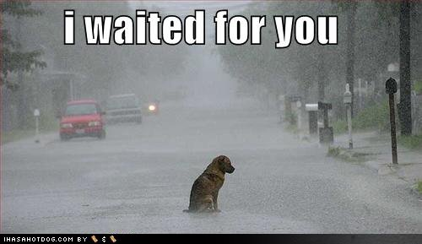
WAITING

Slide 13
STRANGER

Slide 14
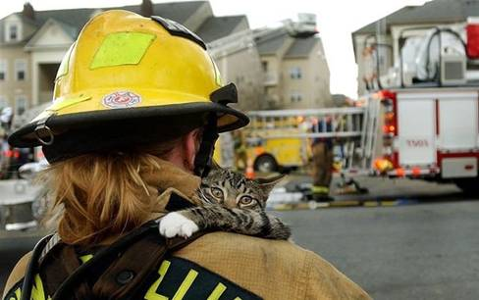
RESCUED

Slide 15
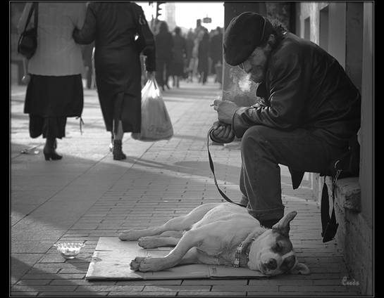
BEST FRIENDS

Slide 16
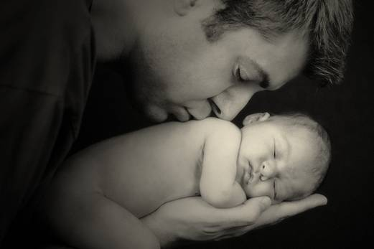
DIVINE

