Slide 1
Parts of the Brain
Notes:
Youtube: How Brains are Built: The Core Story of Brain Development
Brain Power From Neutrons to Networks
EQ: What are the different parts of the brain used for?

Slide 2
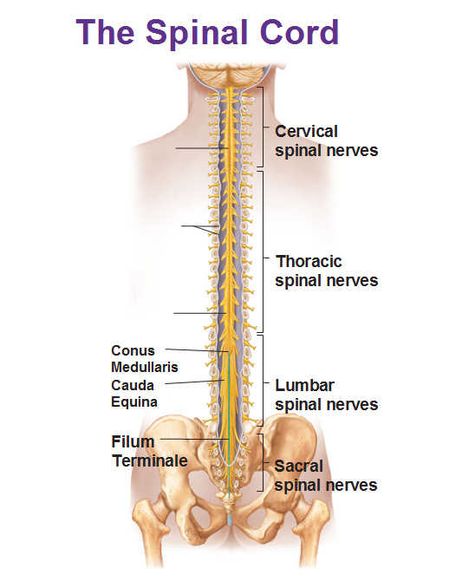
Spinal Cord
The pathway for messages sent by the brain to the body and from the body to the brain. (Grows/develops from fetus to about 4-5 years old).

Slide 3
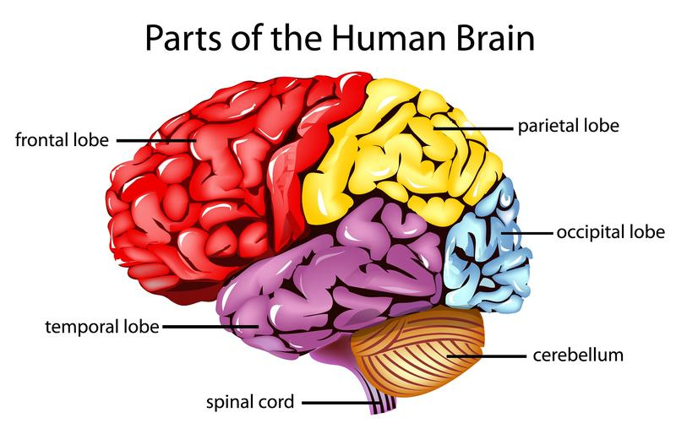
Occipital Lobe
Deals with processing and visual information. (Grows/develops until early 20’s).

Slide 4
Cerebellum
Deals with movement, coordination, balance, and muscle memory. (Grows/develops into adulthood).

Slide 5
Parietal Lobe
Deals with perception, sensory, and spatial awareness. (Grows/develops until adolescence).

Slide 6
Temporal Lobe
Deals with memory, visual, and auditory information. (Grows/develops until late adolescence).

Slide 7
Frontal Lobe
Deals with decision making, planning, impulse, memory, and problem solving. (Grows/develops into mid adulthood 20+ (26)).

Slide 8
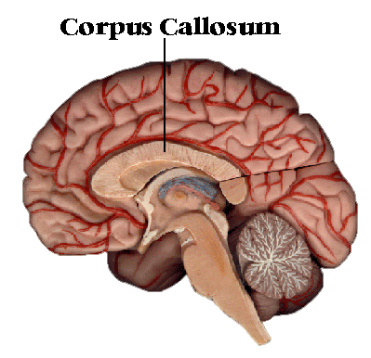
Corpus Callosum
Connects the L/R parts of the brain. Deals with talking, coordination, and the processing of information. (Grows/develops before and during puberty).

Slide 9
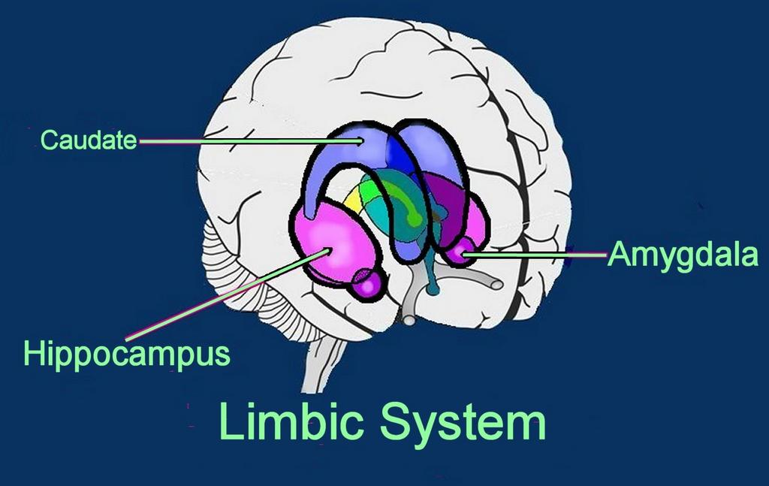
Limbic System (Middle Brain)
Deals with emotional, long term memory (grows/develops into adolescence).
The brain grows from the bottom to the top and the inside out.
Make a fist with both hands; put them together. This is the size and look of the brain. L/R.

