Slide 1
Components of Fitness

Slide 2
1. Cardiovascular Endurance
How well do your heart and lungs work?

Slide 3
2. Muscular Endurance How long can your muscles work?

Slide 4
3. Muscular Strength How hard can your muscles work?

Slide 5
4. Flexibility Can you use your joints’ full Range of Motion?

Slide 6
4. Flexibility Can you use your joints’ full Range of Motion?

Slide 7
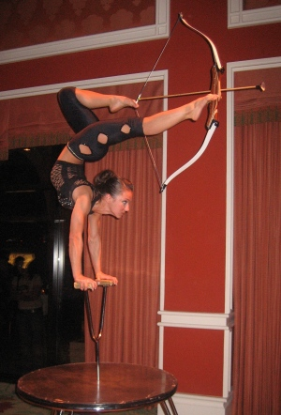
4. Flexibility Can you use your joints’ full Range of Motion?

Slide 8
4. Flexibility Can you use your joints’ full Range of Motion?

Slide 9
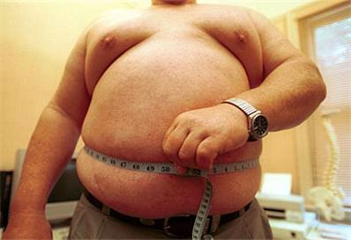
5. Body Composition Do you have a healthy percentage of body fat?

