Slide 1
Chronic Disease
(AKA: lifestyle diseases,
non-communicable diseases,
or diseases of affluence)

Slide 2
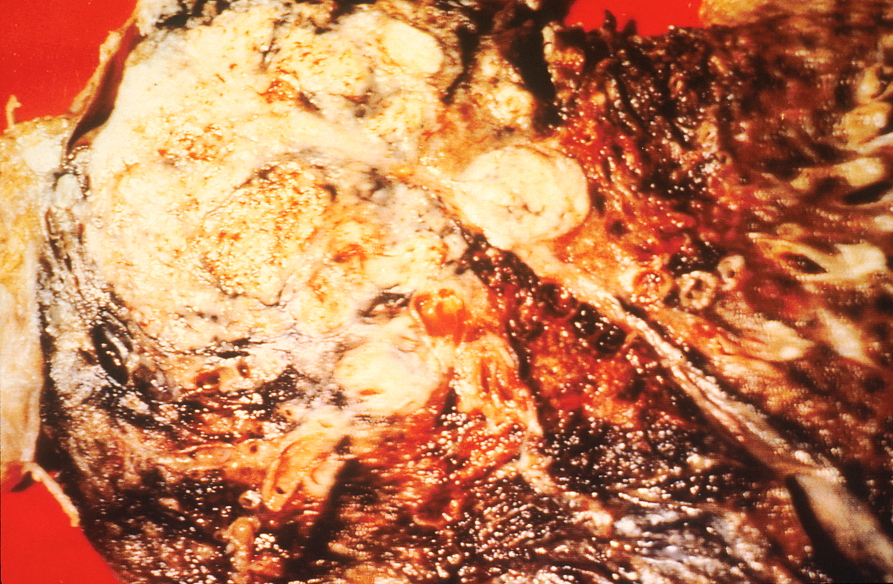
Causes
Unhealthy habits
(Example: lung cancer)

Slide 3
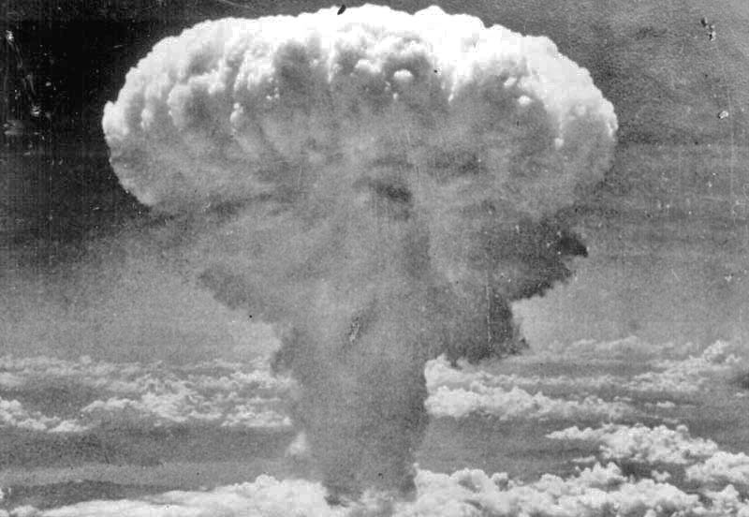
Causes
Environment
(Example: radiation poisoning)

Slide 4
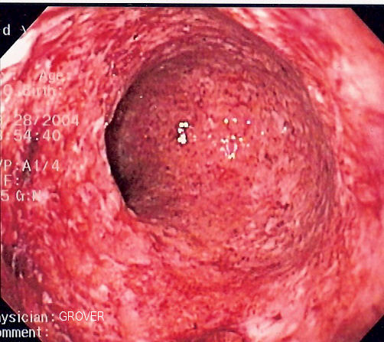
CAUSES
Genetics
(Example: Crohn’s Disease)

Slide 5
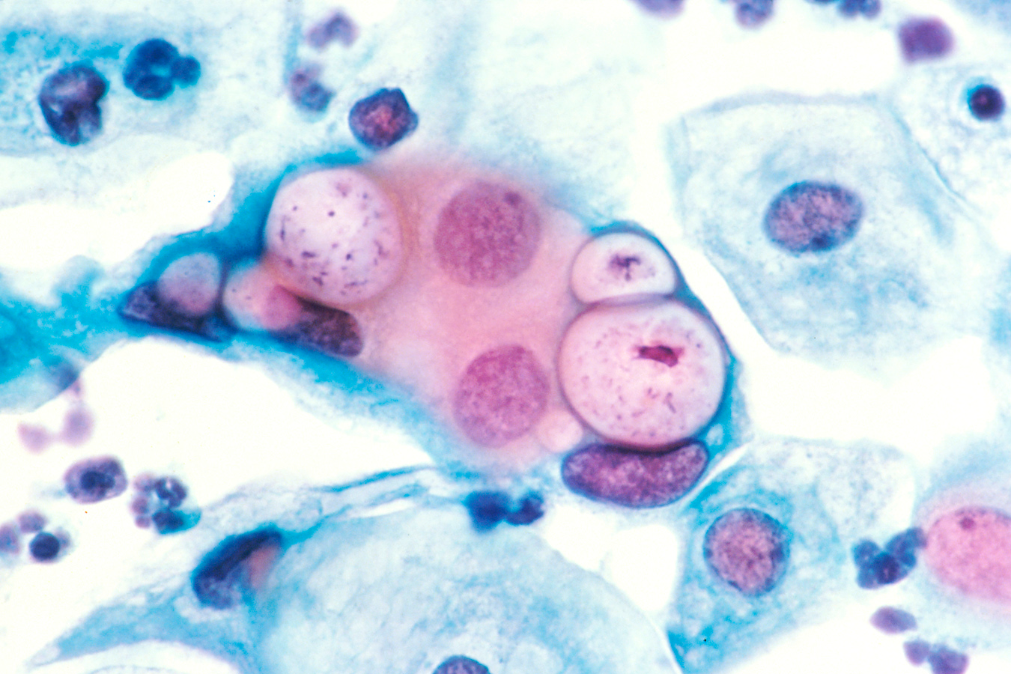
CAUSES
As a result of an infectious disease
(Example: cervical cancer)

Slide 6
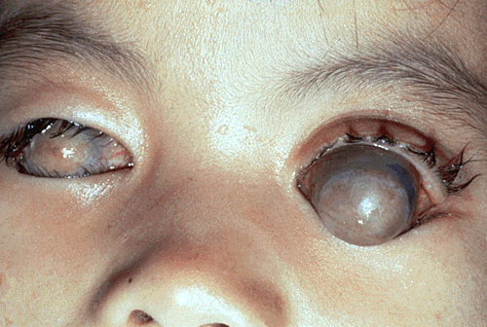
Causes
Poor nutrition
(Example: vitamin A blindness)
WARNING! Disturbing Image!

Slide 7
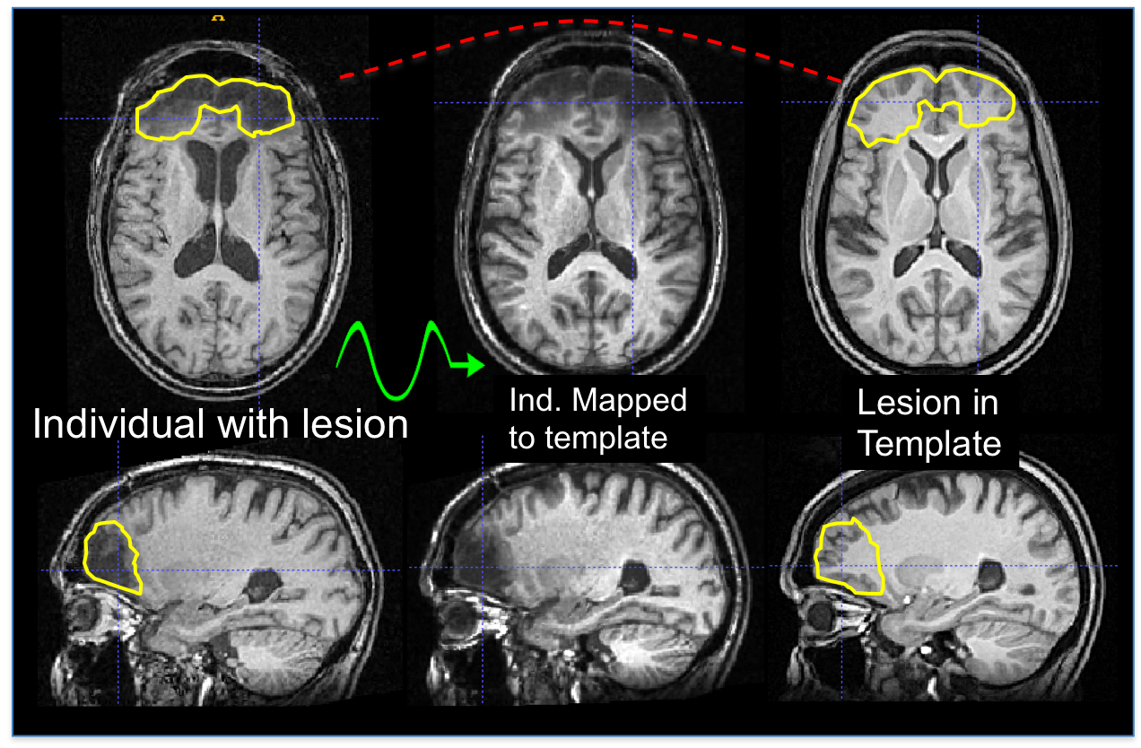
Causes
Injury
(Example: traumatic brain injury)

Slide 8
Causes
Polygenic
(multiple causes)
Genetic Defect
ASTHMA
Air Pollution
Smoking

Slide 9
Prevention
Good health habits
Good nutrition
Healthy environment
Avoiding infectious diseases

Slide 10
Treatment
Surgery
Medication
Changing unhealthy habits

Slide 11
Slideshow of Chronic Diseases

Slide 12
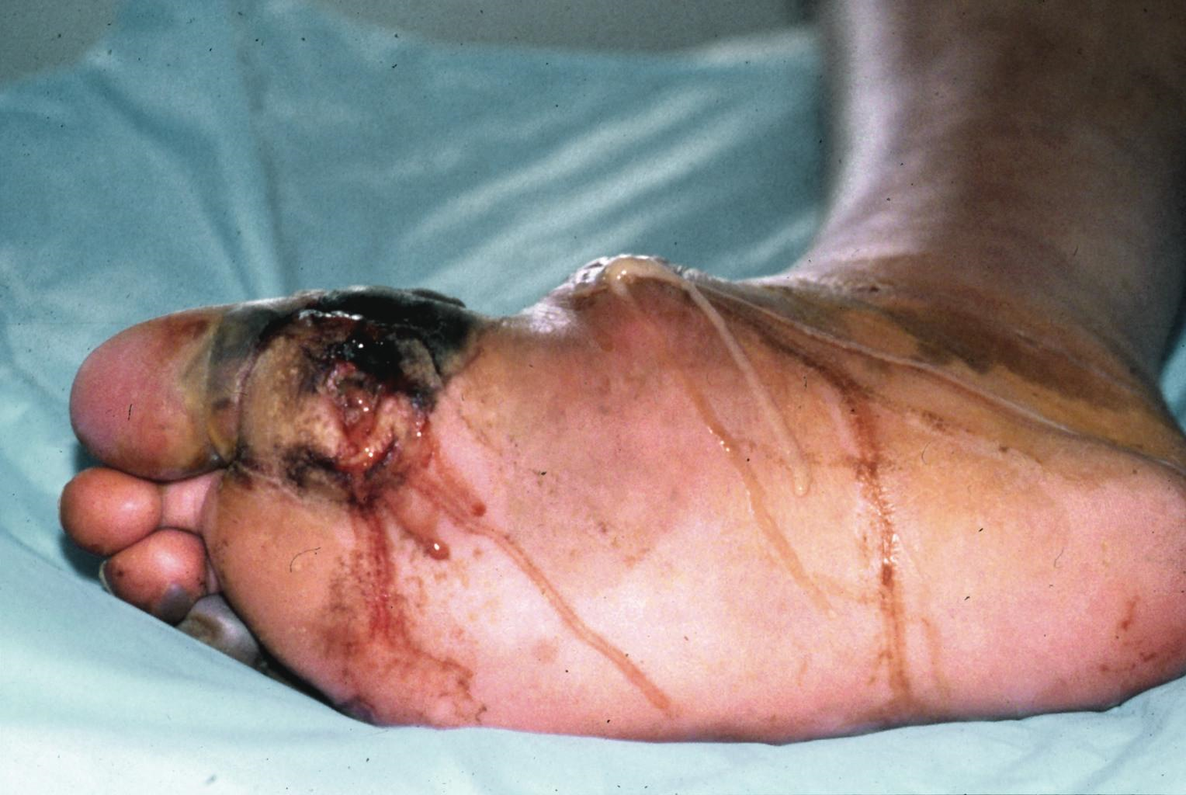
Diabetes
WARNING! Disturbing Image!

Slide 13
Cancer

Slide 14
Heart Disease

Slide 15
Stroke

Slide 16
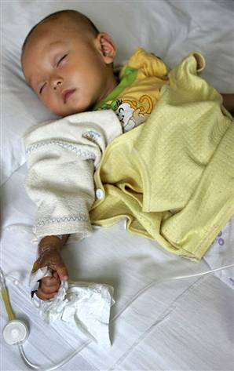
Lead Poisoning

Slide 17
Depression

Slide 18
Down Syndrome

Slide 19
Fetal Alcohol Syndrome

Slide 20
Alzheimer’s Disease

Slide 21
Obesity

Slide 22
High Blood Pressure

Slide 23
Arthritis

Slide 24
Rickets (vit. D deficiency)

