Slide 1
Physical Fitness & Health Status
How can I develop and maintain physical fitness?

Slide 2
Heart health month
February!

Slide 3
How much physical activity do you need?
Regular physical fitness = American Heart Association Recommendation
For Overall Cardiovascular Health:
At least 30 minutes of moderate-intensity aerobic activity at least 5 days per week for a total of 150 OR
At least 25 minutes of vigorous aerobic activity at least 3 days per week for a total of 75 minutes; or a combination of moderate- and vigorous-intensity aerobic activity
AND
Moderate- to high-intensity muscle-strengthening activity at least 2 days per week for additional health benefits.

Slide 4
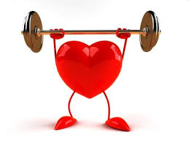
11 Benefits of regular physical fitness
Reduces feelings of depression and anxiety
Promotes psychological well-being
Helps control weight
Reduces the risk of developing type ii diabetes
Builds and maintains healthy bone, muscles, and joints
Reduces risk of premature death
Reduces risk of cardiovascular diseases
Reduces risk of developing high blood pressure
Reduces blood pressure
Reduces the risk of developing colon cancer
Helps older adult body functions and tissues

Slide 5
What is physical fitness?
The ability to preform physical activities and to meet the demands of daily living while being energetic ad alert.

Slide 6
What is physical activity?
Physical activity is anything that makes you move your body and burn calories.

Slide 7
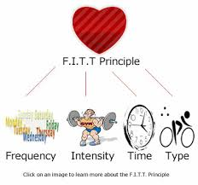
Developing a plan to become physical fit
Design a physical fitness plan = include the goal(s) you want to reach
include a warm up and cool down
5 minutes for each
Use the fit formula
F= frequency
I = intensity
T = time
T = type

Slide 8
Developing a plan to become physical fit
Physical activity
Aerobic exercise
Cardiovascular strength
Cardiovascular endurance
Stretching
Static
dynamic
Resistance exercise
Muscular strength
Muscular endurance

