Slide 1
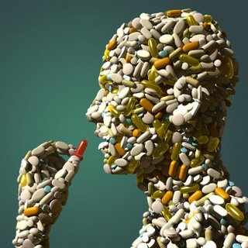
Rx & OTC
Not all drugs are bad…

Slide 2
Prescription Drugs
Abbreviated “Rx”
Require a “prescription” from a doctor

Slide 4
OTC Drugs
Over-the-counter
Generally safe drugs that treat common illnesses

Slide 6
Side-Effects
Unwanted effects of a drug
Does NOT mean that they will occur, just that they might

Slide 7
Drug Interactions
Synergistic
Build on each other
2 + 2 = 15
Ex: Alcohol & barbiturates
Antagonistic
Cancel each other out
2 + 2 = 0
Ex: St John’s wort & antidepressants

Slide 9
Misusing OTC & Rx
Taking a higher dose than the doctor said
Taking a drug longer than the doctor said
Using another’s Rx
Buying these drugs on the streets or internet

Slide 11
Rx & OTC Abuse
Addiction
Death
Organ failure
Car wrecks
Jail time
Switching to other drugs

Slide 12
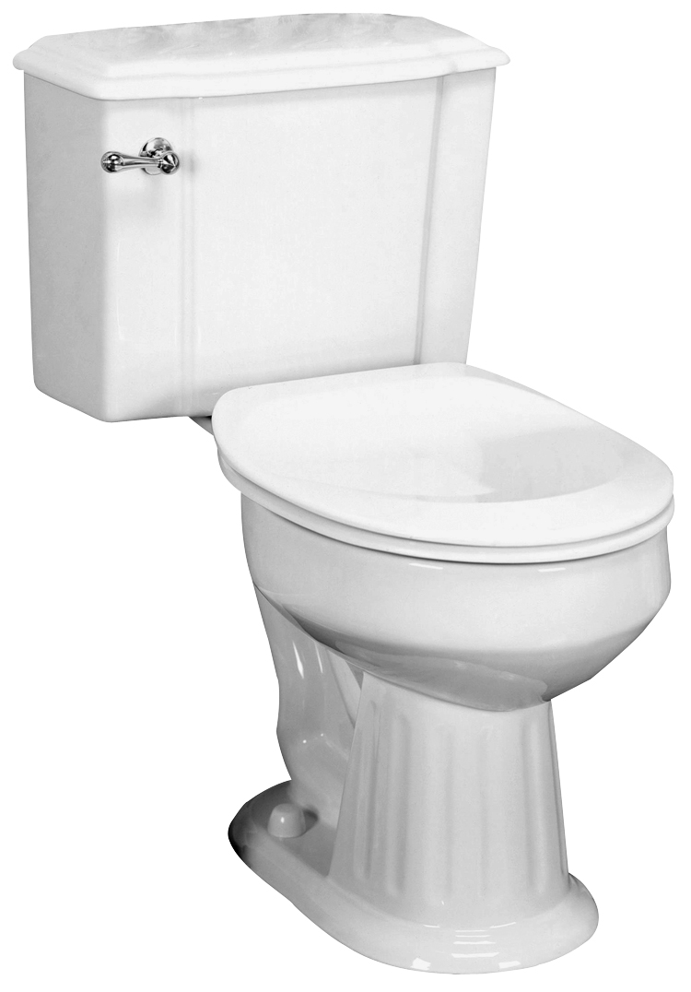
Prevention
Only take as directed to avoid addiction
Store medicines under lock & key
Dispose of old medicines

Slide 14
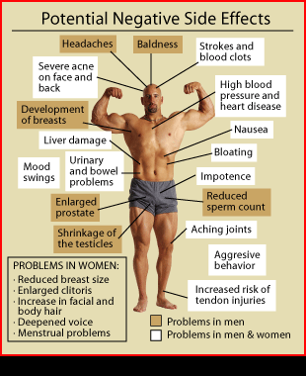
Steroids
SNL Video

