Slide 1
Infectious Diseases
(AKA contagious or communicable diseases)

Slide 2
Infectious Diseases
Anthrax
Bubonic Plague
Cholera
Small Pox
Influenza
Tuberculosis
Typhoid
Measles
Rubella
Mumps
Creutzfeldt-Jakob
Hoof & Mouth
Staph infections
Chicken Pox
Leprosy
Swine Flu (H1N1)
Avian Flu (H5N1)
Spanish Flu (H1N1)
Malaria
Pertussis
Diphtheria
Tetanus
Meningitis
Rabies
Lyme Disease
RM Spotted Fever
Giardia
Hook worm
Tape worm
Sleeping Sickness
Yellow Fever
Hantavirus
Hemorrhagic Fever
Polio

Slide 4
Path of Infection
Host
Vector
Pathogen

Slide 5
Pathogen A life-form that causes a disease
Examples:
Bacterium
Viruses
Parasites
Fungi
Prions

Slide 6
Vector How a pathogen reaches a host
Examples:
Bleeding
Spitting
Kissing
Coughing
Sneezing
Cannibalism
Sex
“Double-dipping” chips
Undercooked food
Parasites

Slide 7
Host An organism that can become infected
Examples:
Humans
Pets
Livestock
Wild animals
Plants

Slide 8
Swine Flu
Pathogen:
H1N1 virus
Vector:
Droplet infection
Host:
Humans (from birds, pigs)
Burden:
Illness, economic impact, increased flu deaths

Slide 9
Bubonic Plague
Pathogen:
Yersinia pestis
Vector:
Fleas on rats
Host:
Humans (rats, fleas, etc.)
Burden:
DEATH
(lots and lots of death)

Slide 10
Zombie
Pathogen:
Zombie Virus
Vector:
Biting (saliva & blood)
Host:
Humans (sometimes dogs)
Burden:
Zombie Apocalypse, people eating each other, etc.

Slide 11
A Closer Look at Pathogens

Slide 12
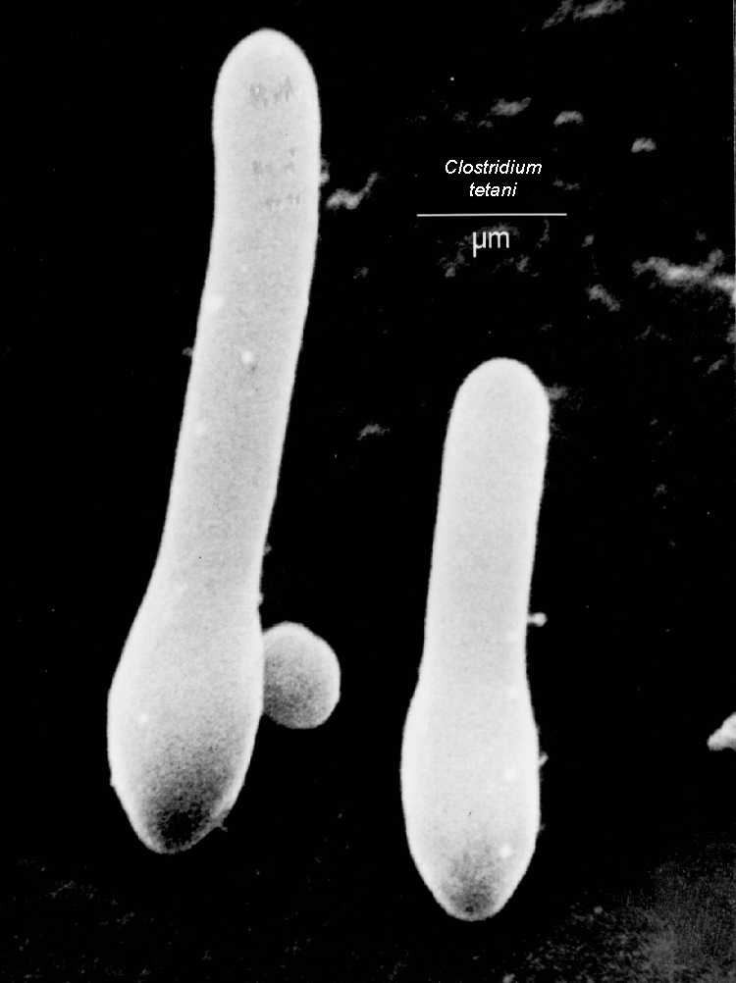
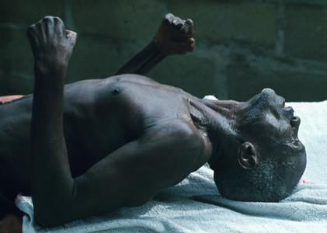
Pathogens
Bacterium
(Example: tetanus)

Slide 13
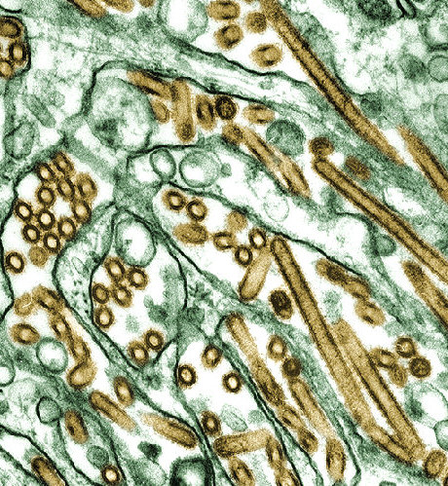
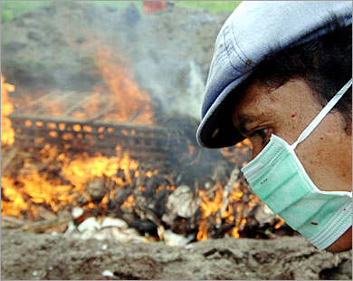
Pathogens
Viruses
(Example: influenza)

Slide 14
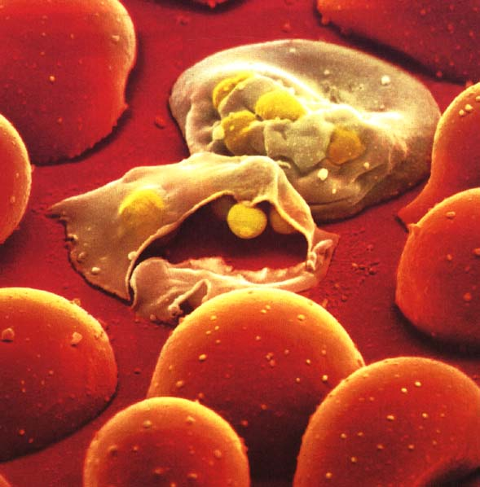
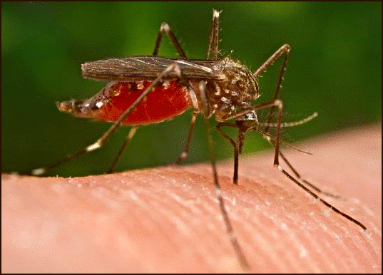
Pathogens
Parasites
(Example: malaria)

Slide 15
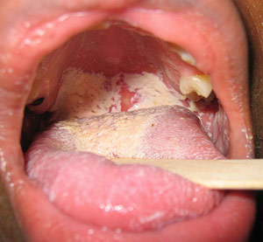
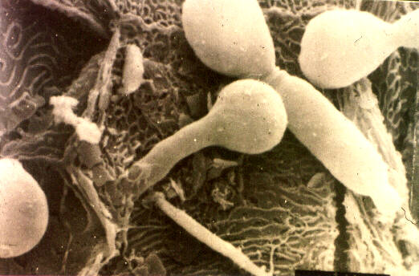
Pathogens
Fungi
(Example: yeast infections)

Slide 16
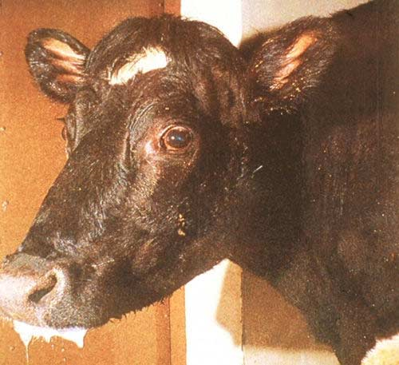
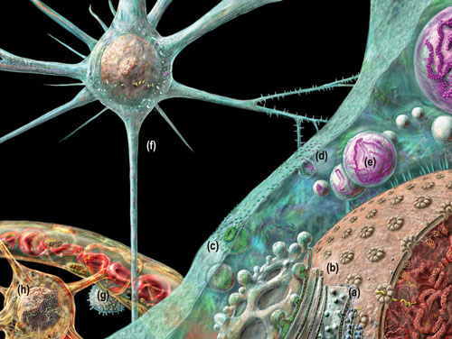
Pathogens
Prions
(Example: Creutzfeldt-Jakob)

Slide 17
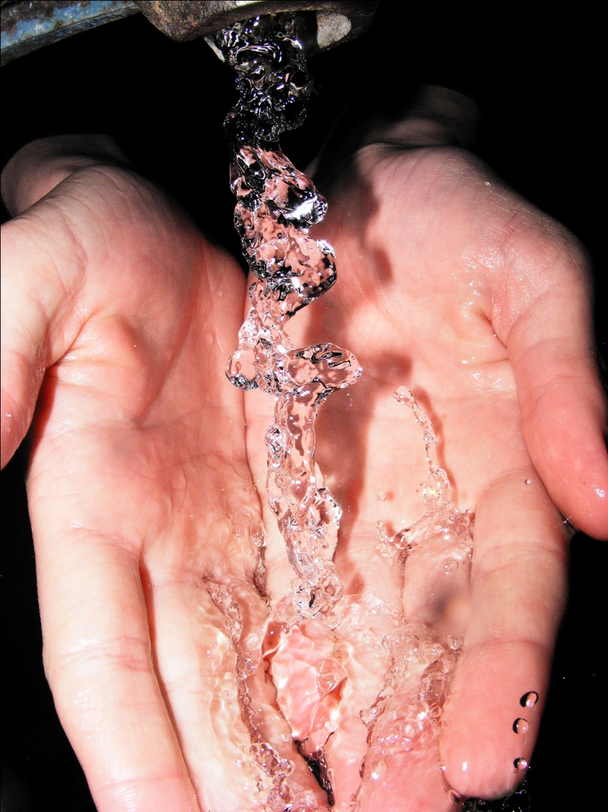
Infectious Disease—PREVENTION
Good Hygiene

Slide 18
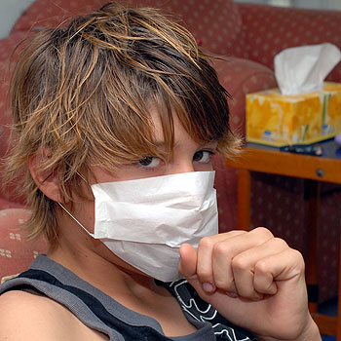
Infectious Disease—PREVENTION
Good Hygiene
Quarantine

Slide 19
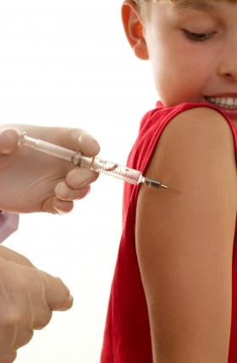
Infectious Disease—PREVENTION
Good Hygiene
Quarantine
Vaccination

Slide 20
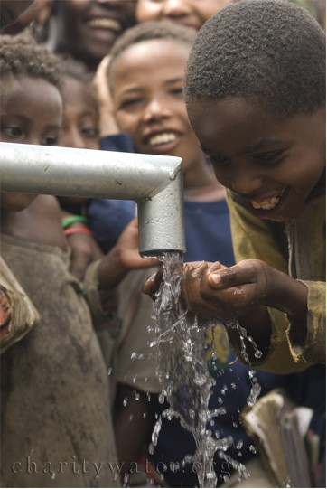
Infectious Disease—PREVENTION
Good Hygiene
Quarantine
Vaccination
Public Sanitation

Slide 21
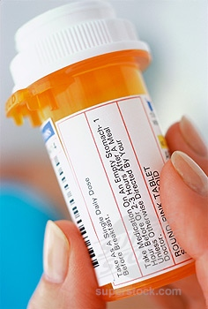
Infectious Disease—TREATMENT
Immune System
Antibiotics
Antiviral Drugs
Antifungal Drugs

