Slide 2
Food Safety
10 Ways to Reduce the Risk of
Foodborne Illnesses

Slide 3
1. Wash Your Hands

Slide 4
2. Wash Produce

Slide 5
3. Cook Meat to 165 °F

Slide 6
4. Don’t Cross-Contaminate

Slide 7
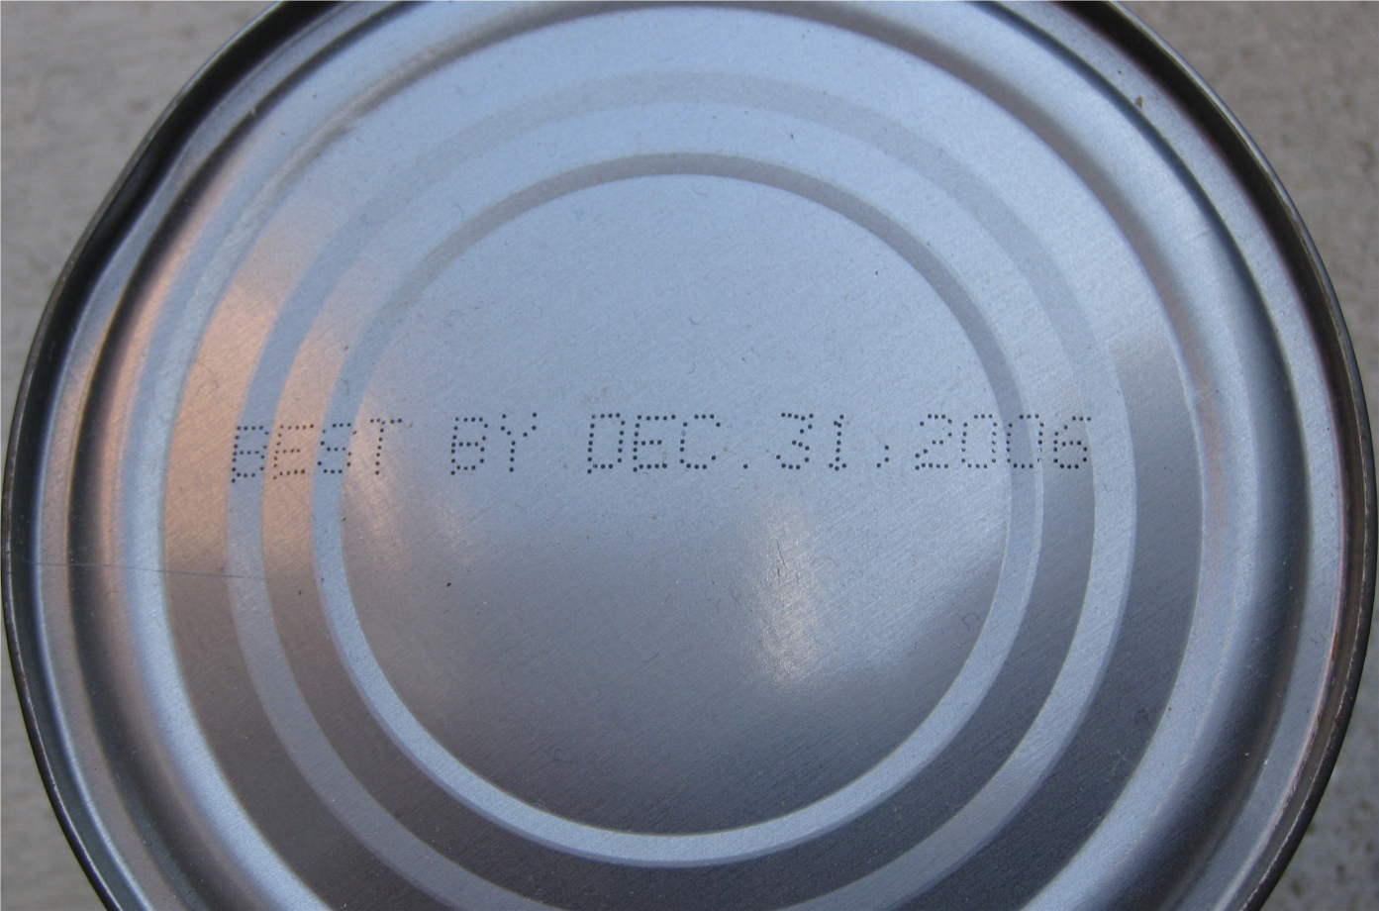
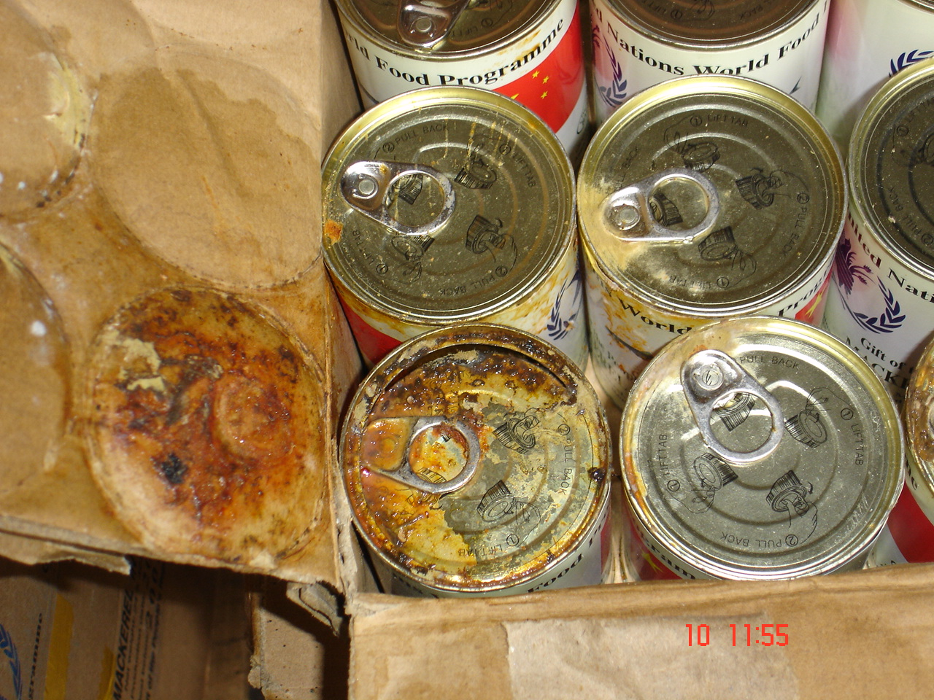
5. Watch for Signs of Bad Food

Slide 8
6. Store Food in a Fridge or Freezer

Slide 9
7. Use Leftovers within 2 Days

Slide 10
8. Use Before the Expiration Date

Slide 11
9. Be Safe When Eating Out

Slide 12
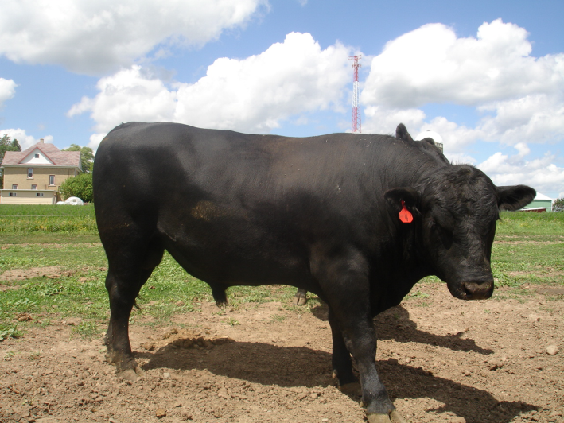
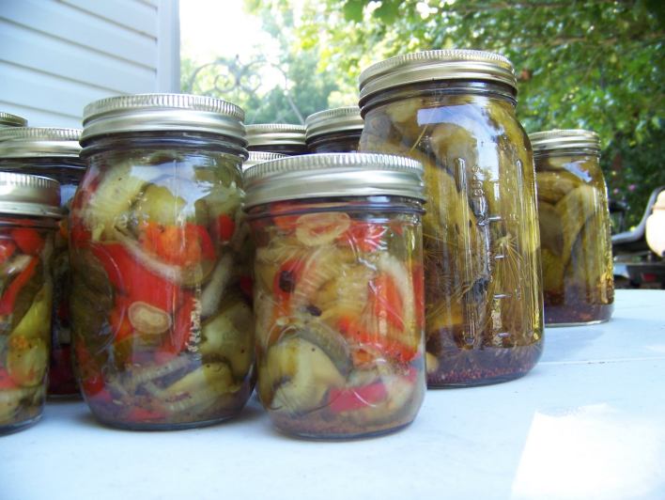
10. Farm, Hunt, & Can Safely

Slide 13
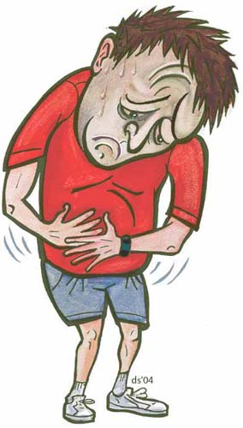
For More Information Go To…
http://www.foodsafety.gov
http://www.stilltasty.com/

