Slide 1
Stress (Worry)

Slide 2
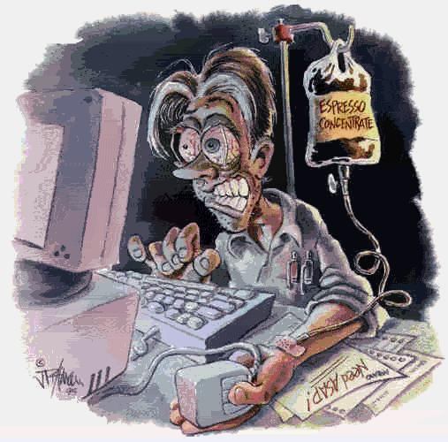

Slide 3
Health Effects of Stress
Sweating
Muscle tension
Stomach aches
Diarrhea
Gas
Longer healing time
High blood pressure
Headaches
Migraines
Hyperactivity
Nervous habits
Irritability
Depression
Anxiety
Back pain
Weight change
Difficulty making decisions
Chronic disease flare-ups
Insomnia
Oversleeping

Slide 5
Stressor:
Anything that causes stress
2 Types
Eustress—good
Distress—bad
Write down 5 of
your stressors

Slide 6
Teenage Stress Statistics
85% of teenagers say that they feel stressed at least some of the time
45% of teenage girls feel stressed frequently
45% of teenage boys feel stressed frequently
Teenagers in urban areas are more stressed
Teenagers from middle class families have the most stress
Teenagers are 10% more likely to be stressed than adults

Slide 7
GROUP ACTIVITY
What do you think are the ten most common stressors for junior high school students?

Slide 8
The most common stressor for teens…
SCHOOL

Slide 9
BIGGEST Stressors for Teens
Death of a parent or guardian
Death of a brother, sister, or close friend
Father or mother losing a job
Becoming a teenage parent
Serious illness of a loved one
Divorce of parents
Trouble with the police
Serious injury or illness
Getting dumped by BF/GF
Being physically assaulted
Starting to use drugs
Failing a class in school
Being pressured to use drugs
Getting your driver’s license
Loss of a part-time job
Moving to a different town or school
Being pressured to have sex
Starting to date
Taking final exams
Performing or participating in a performance (e.g., drama, music, speeches)
Having trouble with a teacher, principal, or boss
Receiving a poor grade or report card
Receiving a recognition for outstanding achievement

